Slide 1
Becoming a successful real estate agent
Memo Vargas
Chief Empowerment Officer

Slide 2
Becoming a successful ME!
Is a lie!!!!
Memo Vargas
Chief Empowerment Officer

Slide 3
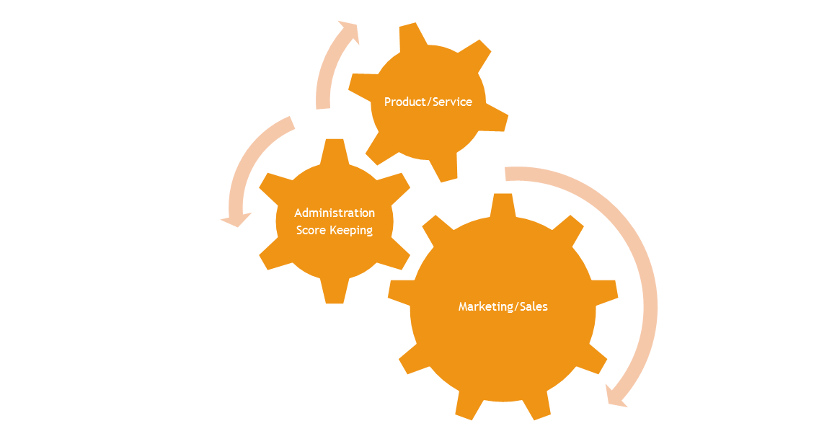
Content
Success
How
Who
Why
When
Legacy

Slide 4
Success
The favorable or prosperous termination of attempts or endeavors; the accomplishment of one's goals.
Success is a journey, not a destination
Success is an inside job, MINDSET

Slide 5
Memo’s view of success

Slide 6
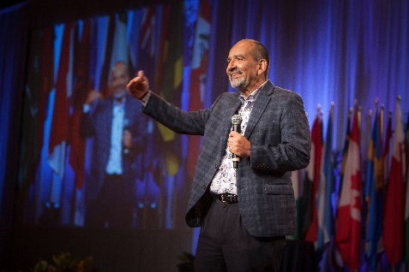
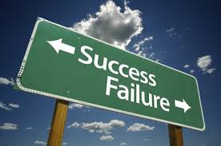
WHY, The Heart of my Business
Vision
Mission
Values
Who
Do
I
Want
To
Become
Why
Do
I
Want
To
Become
What
Principles
Do
I
Believe
in

Slide 7
HOW, You Realty Blue Print
Success
Marketing
Real Estate
Leader
Admin
Score
Legacy

Slide 8
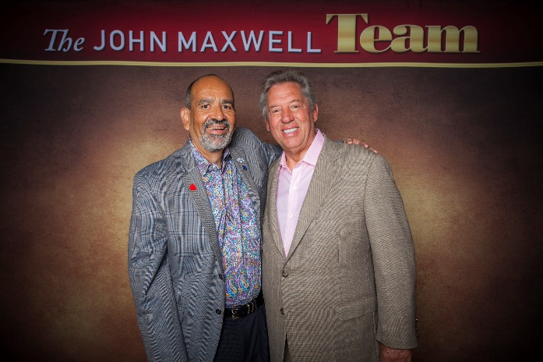
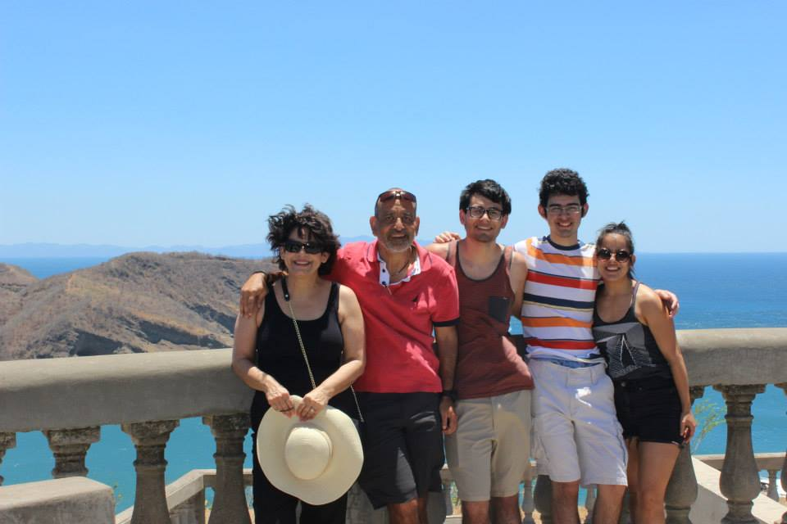
WHO is going to help you

Slide 9
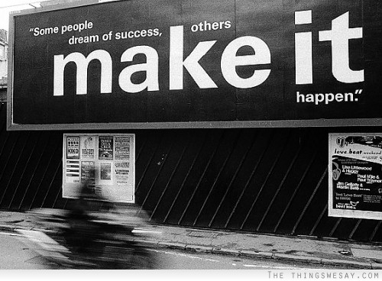
WHAT am I going to do? Ooops

Slide 10
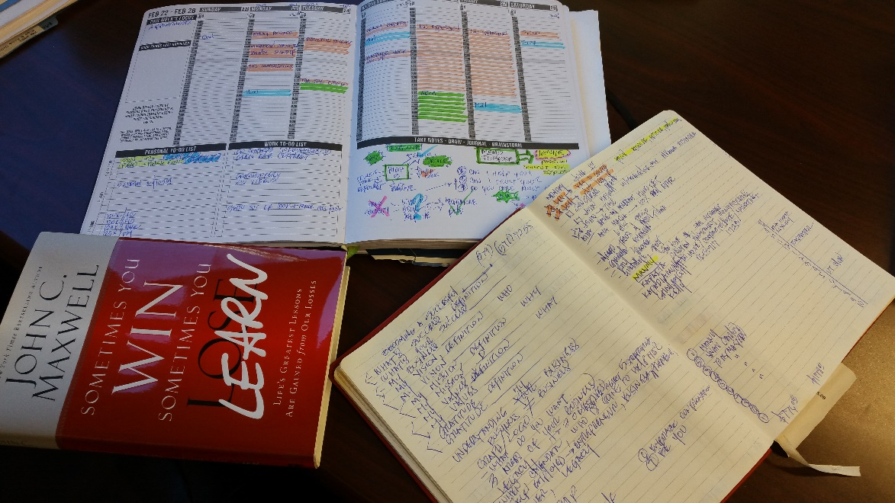
WHEN am I going to do it?
Why
Business
Take Action
What do I want?
What would I drive?
When will I make it happen?

Slide 11
Muchas Gracias!!!
Ignite the greatness within you!
Believe & be a proud REALTOR
Share your passion with others
Don’t keep sight out of the score
Leave and live this world better than you found it!
Memo Vargas, Chief Empowerment Officer

Slide 12
Becoming Mastermind Program

Slide 13
Becoming a Successful Me Mastermind Program
8 Weeks
$299
Clarify Success
Discover Why
Identify Business
Service
Marketing/Sales
Accountability
Leadership
Success Plan Presentation
DISC Profile
Wheel of life
Build your business model
Your message
Building your Team
Success Trackers
Accountability Partner
Leadership-influence
Coaching/mentoring

